Slide 1

AI-POWERED BANKING SOLUTION
BankBot AI
Intelligent Chatbot for
Banking FAQs & Services
Redefining Banking Accessibility with AI
Prepared By
Vallivedu Madhuri Reddy

Slide 2
Vision & Problem Statement
Technology Stack & Architecture
01
02
Understanding banking challenges and AI-driven solutions
System design and technical implementation
PROJECT ROADMAP
Table of
Contents
Milestone 1: Intent Recognition
03
04
Milestone 2: UI & Database
Natural language understanding foundation
User interface and data management
Milestone 3: Banking Operations
Milestone 4: Admin Panel
A comprehensive journey through BankBot AI's development lifecycle, from concept to deployment.
05
06
Core banking features implementation
Analytics and management dashboard
07
Benefits & Impact
Business value and user transformation

Slide 3
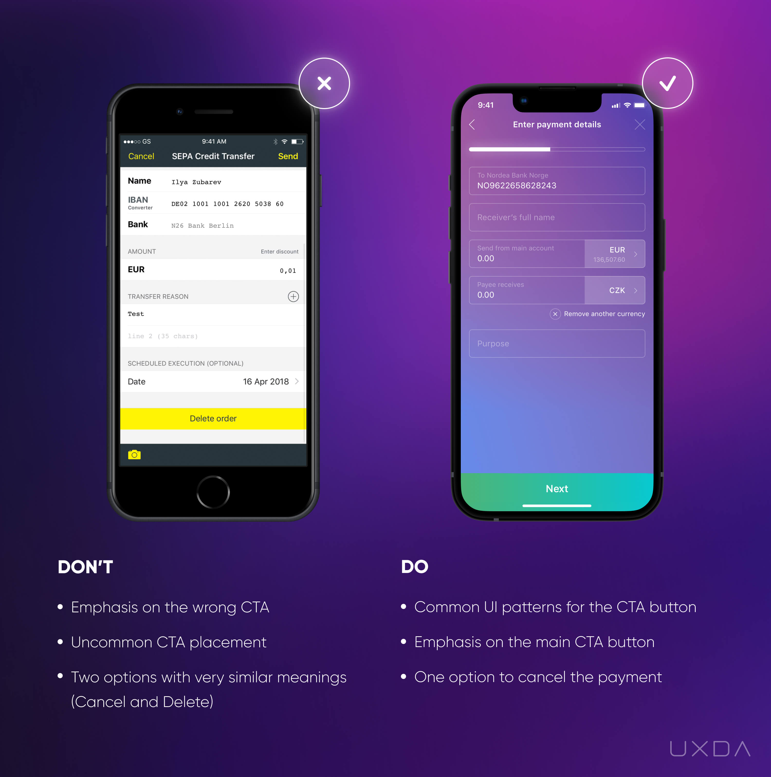
PROJECT VISION
A Personal Banker in Your Pocket
Our Mission
To democratize access to financial information by leveraging Natural Language Processing (NLP) to understand user intent and provide accurate, secure, and human-like responses instantly.
Key Objectives
Automate Banking FAQs: Provide instant answers to common queries
Reduce Manual Workload: Minimize human agent dependency
Improve User Experience: Deliver seamless 24/7 support
Enable Admin Monitoring: Provide comprehensive analytics
Conversational AI at Your Fingertips
Experience the future of banking through natural language conversations

Slide 4
PROBLEM & SOLUTION
The Challenge & Our Solution
The Problem
Our Solution
Long Wait Times
24/7 Conversational Interface
Customers face extended queues for simple queries like balance checks and transaction history
BankBot AI provides round-the-clock instant support through natural language conversations
Limited Working Hours
Intent Understanding
Traditional support operates only during business hours, leaving users frustrated during off-times
Advanced NLP algorithms accurately interpret user queries and deliver precise responses
High Operational Costs
Instant & Secure Responses
Maintaining large customer support teams increases overhead for financial institutions
Real-time query resolution with robust security protocols for sensitive banking data
Reduced Satisfaction
Enhanced Customer Satisfaction
Delayed responses and limited availability negatively impact customer experience
Improved user experience through immediate assistance and personalized interactions

Slide 5
TECHNICAL FOUNDATION
System Architecture
Modular design ensuring security and scalability
User Interface
NLP Layer
Business Logic
Database
Response Generation
Streamlit web app
Register/Login
Chat interface
Intent classification
Entity extraction
Grok LLM API
Python backend
Authentication
Banking operations
SQLite database
User data storage
Chat history
Dynamic responses
Context awareness
Real-time delivery
Security
Scalability
Integration
Multi-layered security with JWT authentication, encrypted data transmission, and secure API endpoints
Modular components allow independent scaling to handle increasing user load and feature expansion
Seamless integration with external APIs, banking systems, and third-party services via RESTful endpoints

Slide 6
TECHNICAL IMPLEMENTATION
Technology Stack
Powerful technologies driving BankBot AI
Frontend
Backend
Streamlit: Rapid web app development
Python: Core application logic
HTML/CSS: Responsive interface design
Flask/Django: API framework
JavaScript: Interactive components
JWT: Secure authentication
Database
AI/NLP
Intelligence Engine
SQLite: Lightweight relational DB
Intent Classification: Query understanding
User Tables: Account management
Grok LLM API: Dynamic responses
Chat History: Conversation logs
Entity Extraction: Data parsing

Slide 7
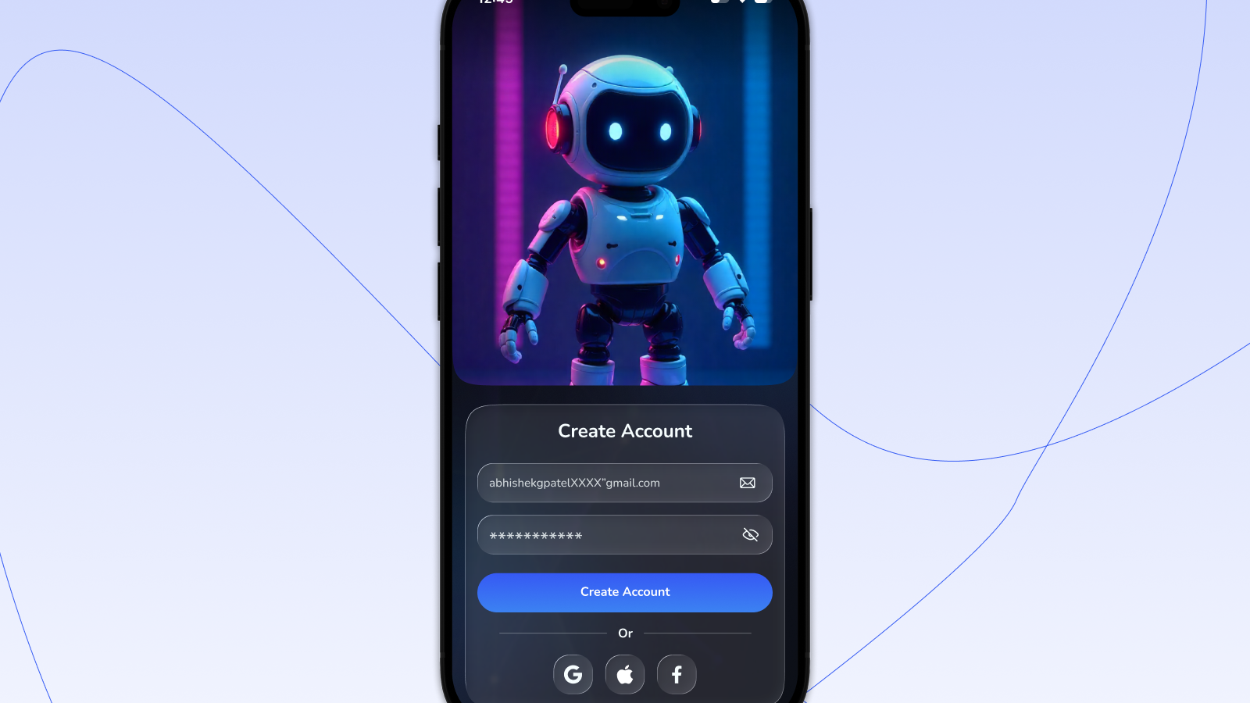
01
Milestone 1:
Intent Recognition
Building the Foundation of
Natural Language Understanding
Balance Check
Mini Statement
Smart FAQs

Slide 8
MILESTONE 1: IMPLEMENTATION
Core Features & Pipeline
Balance Check
Milestone 1 Pipeline
heck their account balance anytime using natural language queies.
1
User Query
Customer types natural language query
2
Text Preprocessing
Mini Statement
Tokenization, normalization, cleaning
View the last 5 transactions instantly to track recent spending activity. Provides quick access to recent transaction history without navigating complex menus.
3
Intent Detection
ML model identifies user intent
Smart FAQs
4
Backend Logic
Process request and fetch data
Automated answers to common questions regarding bank policies, hours, and services. Reduces repetitive queries to human agents.
5
Response
Generate and deliver response

Slide 9
MILESTONE 1: TECHNICAL DETAILS
Intent Recognition Engine
How natural language understanding works
Intent Definition
Text Preprocessing
Defined key intents for banking operations with sample utterances:
Tokenization
Normalization
check_balance
Split into tokens
Lowercase, remove punctuation
"What's my balance?", "Show account balance"
mini_statement
Stop Words
Lemmatization
"Recent transactions", "Show my last 5 transactions"
Remove common words
Reduce to base form
banking_faq
"What are your hours?", "Bank policies"
Intent Detection with Confidence
NLU Model Training
ML model predicts intent with confidence scores:
Built and trained Natural Language Understanding model using spaCy/Rasa NLU with intent classification and entity extraction capabilities.
check_balance
95%
mini_statement
87%
banking_faq
78%

Slide 10

02
Milestone 2:
UI & Database
Creating Seamless User Experience
& Data Management
User Registration
Secure Login
Chat Interface

Slide 11
MILESTONE 2: IMPLEMENTATION
Core Features & Pipeline
User Interface Features
Database Management
User Registration
SQLite Integration
Secure user registration with email validation, password hashing, and account setup
Lightweight serverless database for storing user data, chat history, and banking information with SQL operations
Login System
JWT-based authentication with session management and secure credential validation
User Data Management
Comprehensive user profile storage including personal details, account settings, and authentication data
Chatbot Application
Interactive chat interface with real-time messaging, typing indicators, and conversation history
Chat History Storage
Persistent conversation logging with timestamps, intent tracking, and message archiving for analysis
Chat Analysis UI
Visual analytics dashboard showing conversation metrics and user engagement data
CRUD Operations
Create, Read, Update, Delete operations for user management, data modification, and system maintenance
Milestone 2 Pipeline
User Login
DB Validation
Chat Interface
Response

Slide 12
MILESTONE 2: USER EXPERIENCE
ChatBot Interface
Seamless conversational banking experience
ChatBot Home Page
Key Features
Real-time Messaging
Instant response generation with typing indicators
BankBot AI
Conversation History
Your intelligent banking assistant - ready to help you 24/7 with all your banking needs.
Persistent chat logs with timestamps
Responsive Design
User
Mobile-friendly interface for all devices
What's my account balance?
User-Friendly Navigation
Intuitive layout with clear options
BankBot AI
Your current account balance is $12,450.00. Is there anything else I can help you with today?
Additional Functionality
Help & Support
Comprehensive help system with usage guides
Chat Analysis
Analytics dashboard for conversation insights

Slide 13

03
Milestone 3:
Banking Operations
Enabling Secure Banking
Transactions with AI
Transfer Money
Find ATM
Loan Details
Block Card

Slide 14
MILESTONE 3: IMPLEMENTATION
Core Features & Pipeline
Transfer Money
Check Balance
Find ATM
Loan Details
Block Card
Secure fund transfers between accounts with recipient validation and amount verification.
Real-time account balance retrieval across multiple account types (savings, checking).
Location-based ATM finder with nearest branch suggestions and navigation.
Comprehensive loan information including eligibility, interest rates, and repayment.
Instant card blocking functionality for lost or stolen cards with fraud prevention.
Milestone 3 Pipeline
1
2
3
4
5
6
User Query
Intent
Entity Extraction
Business Logic
Database
Response

Slide 15
MILESTONE 3: AI INTEGRATION
Advanced Banking Features
Powered by Grok LLM API for intelligent conversations
Grok LLM Integration
Loan Information
Integrated Grok LLM API enables dynamic, context-aware responses. The AI understands complex queries, maintains conversation context, and generates human-like responses for natural banking interactions.
Comprehensive loan details with eligibility:
Personal loan details
Home loan information
Interest rates & eligibility
Money Transfer
Advanced entity extraction for secure transfers:
Card Security
User: "Send $500 to John Doe"
Instant card blocking with fraud detection. Users can immediately block lost/stolen cards through simple commands, with confirmation and next steps provided.
Extracted: Amount: $500, Recipient: John Doe
ATM Finder
Context Awareness
Location-based ATM search using entity extraction to identify user location and provide nearest ATM suggestions with real-time availability status.
Maintains conversation context throughout the session, remembers user preferences, and provides personalized responses based on previous interactions.

Slide 16
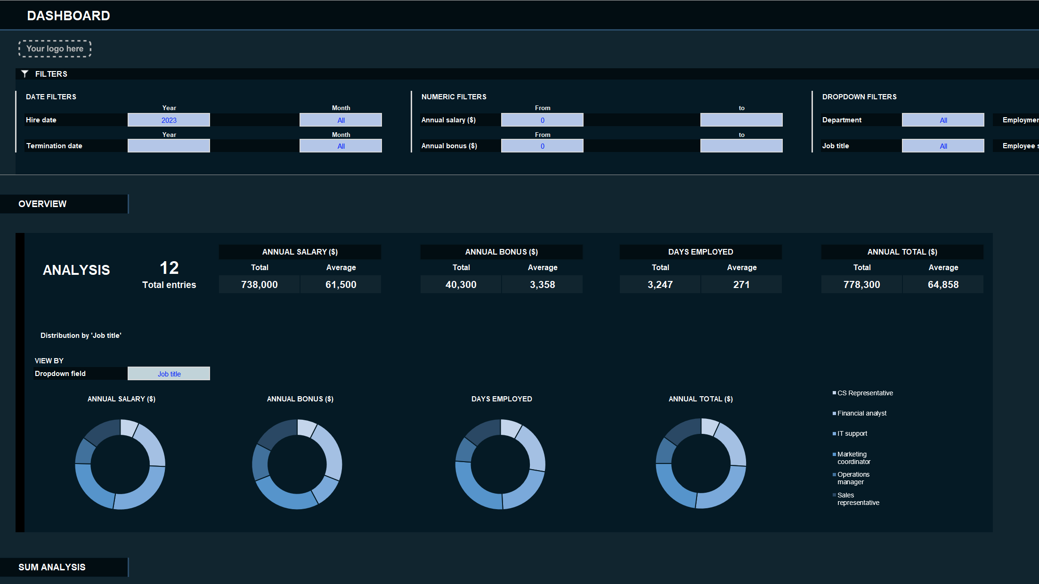
04
Milestone 4:
Admin Panel
Comprehensive Analytics &
Management Dashboard
Intent Manager
Chat Analysis
Export & Reports
User Management

Slide 17
MILESTONE 4: ADMINISTRATION
Core Features & Pipeline
Intent Manager
Milestone 4 Pipeline
Complete CRUD operations for managing intents:
Chat Analysis
Visual analytics with multiple representations:
1
Admin Login
Create: Add new intents and training examples
Secure admin authentication
Intent distribution charts
User query frequency graphs
Read: View and search existing intents
Response time metrics
Chat Logs
2
Update: Modify intent definitions
Access conversation history
3
Analytics
User Management
Generate insights and reports
Export & Reports
Multiple export formats available:
Complete user administration:
4
Export
View all registered users
Download data in multiple formats
Manage user permissions
JSON
HTML
Markdown
Monitor user activity

Slide 18
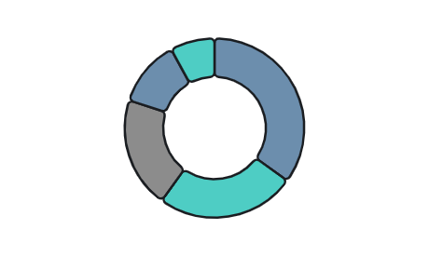
MILESTONE 4: DASHBOARD
Admin Dashboard & Analytics
Comprehensive monitoring and management interface
Admin Dashboard Interface
Intent Distribution
1,247
8,954
92%
Total Users
Conversations
Accuracy
Intent Management Panel
check_balance
EDIT
DELETE
mini_statement
EDIT
DELETE
Model Training
Export Functionality
Administrators can trigger model retraining from the UI:
JSON
HTML
Markdown
Update Training Data
Add new examples to existing intents
Trigger Retraining
Initiate model update process
Retrain Model

Slide 19
BUSINESS VALUE
Benefits & Business Impact
Transforming banking operations with AI
24/7 Availability
Faster Response
Round-the-clock customer support ensures users receive instant assistance anytime, eliminating wait times and improving satisfaction.
Instant query resolution delivers immediate answers, drastically reducing response times from minutes to seconds for enhanced user experience.
24/7
0s
100%
<3s
95%
10x
Availability
Wait Time
Uptime
Response
Accuracy
Faster
Reduced Cost
Scalable Solution
Automation reduces operational expenses by minimizing human agent dependency, allowing staff to focus on complex, high-value customer interactions.
Modular architecture enables seamless scaling to handle increasing user loads and expand banking services without performance degradation.
60%
40%
ROI
1000+
∞
99.9%
Cost Saving
Less Staff
300%+
Users
Scale
Uptime

Slide 20
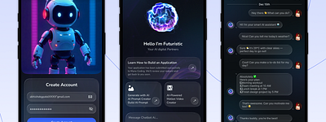
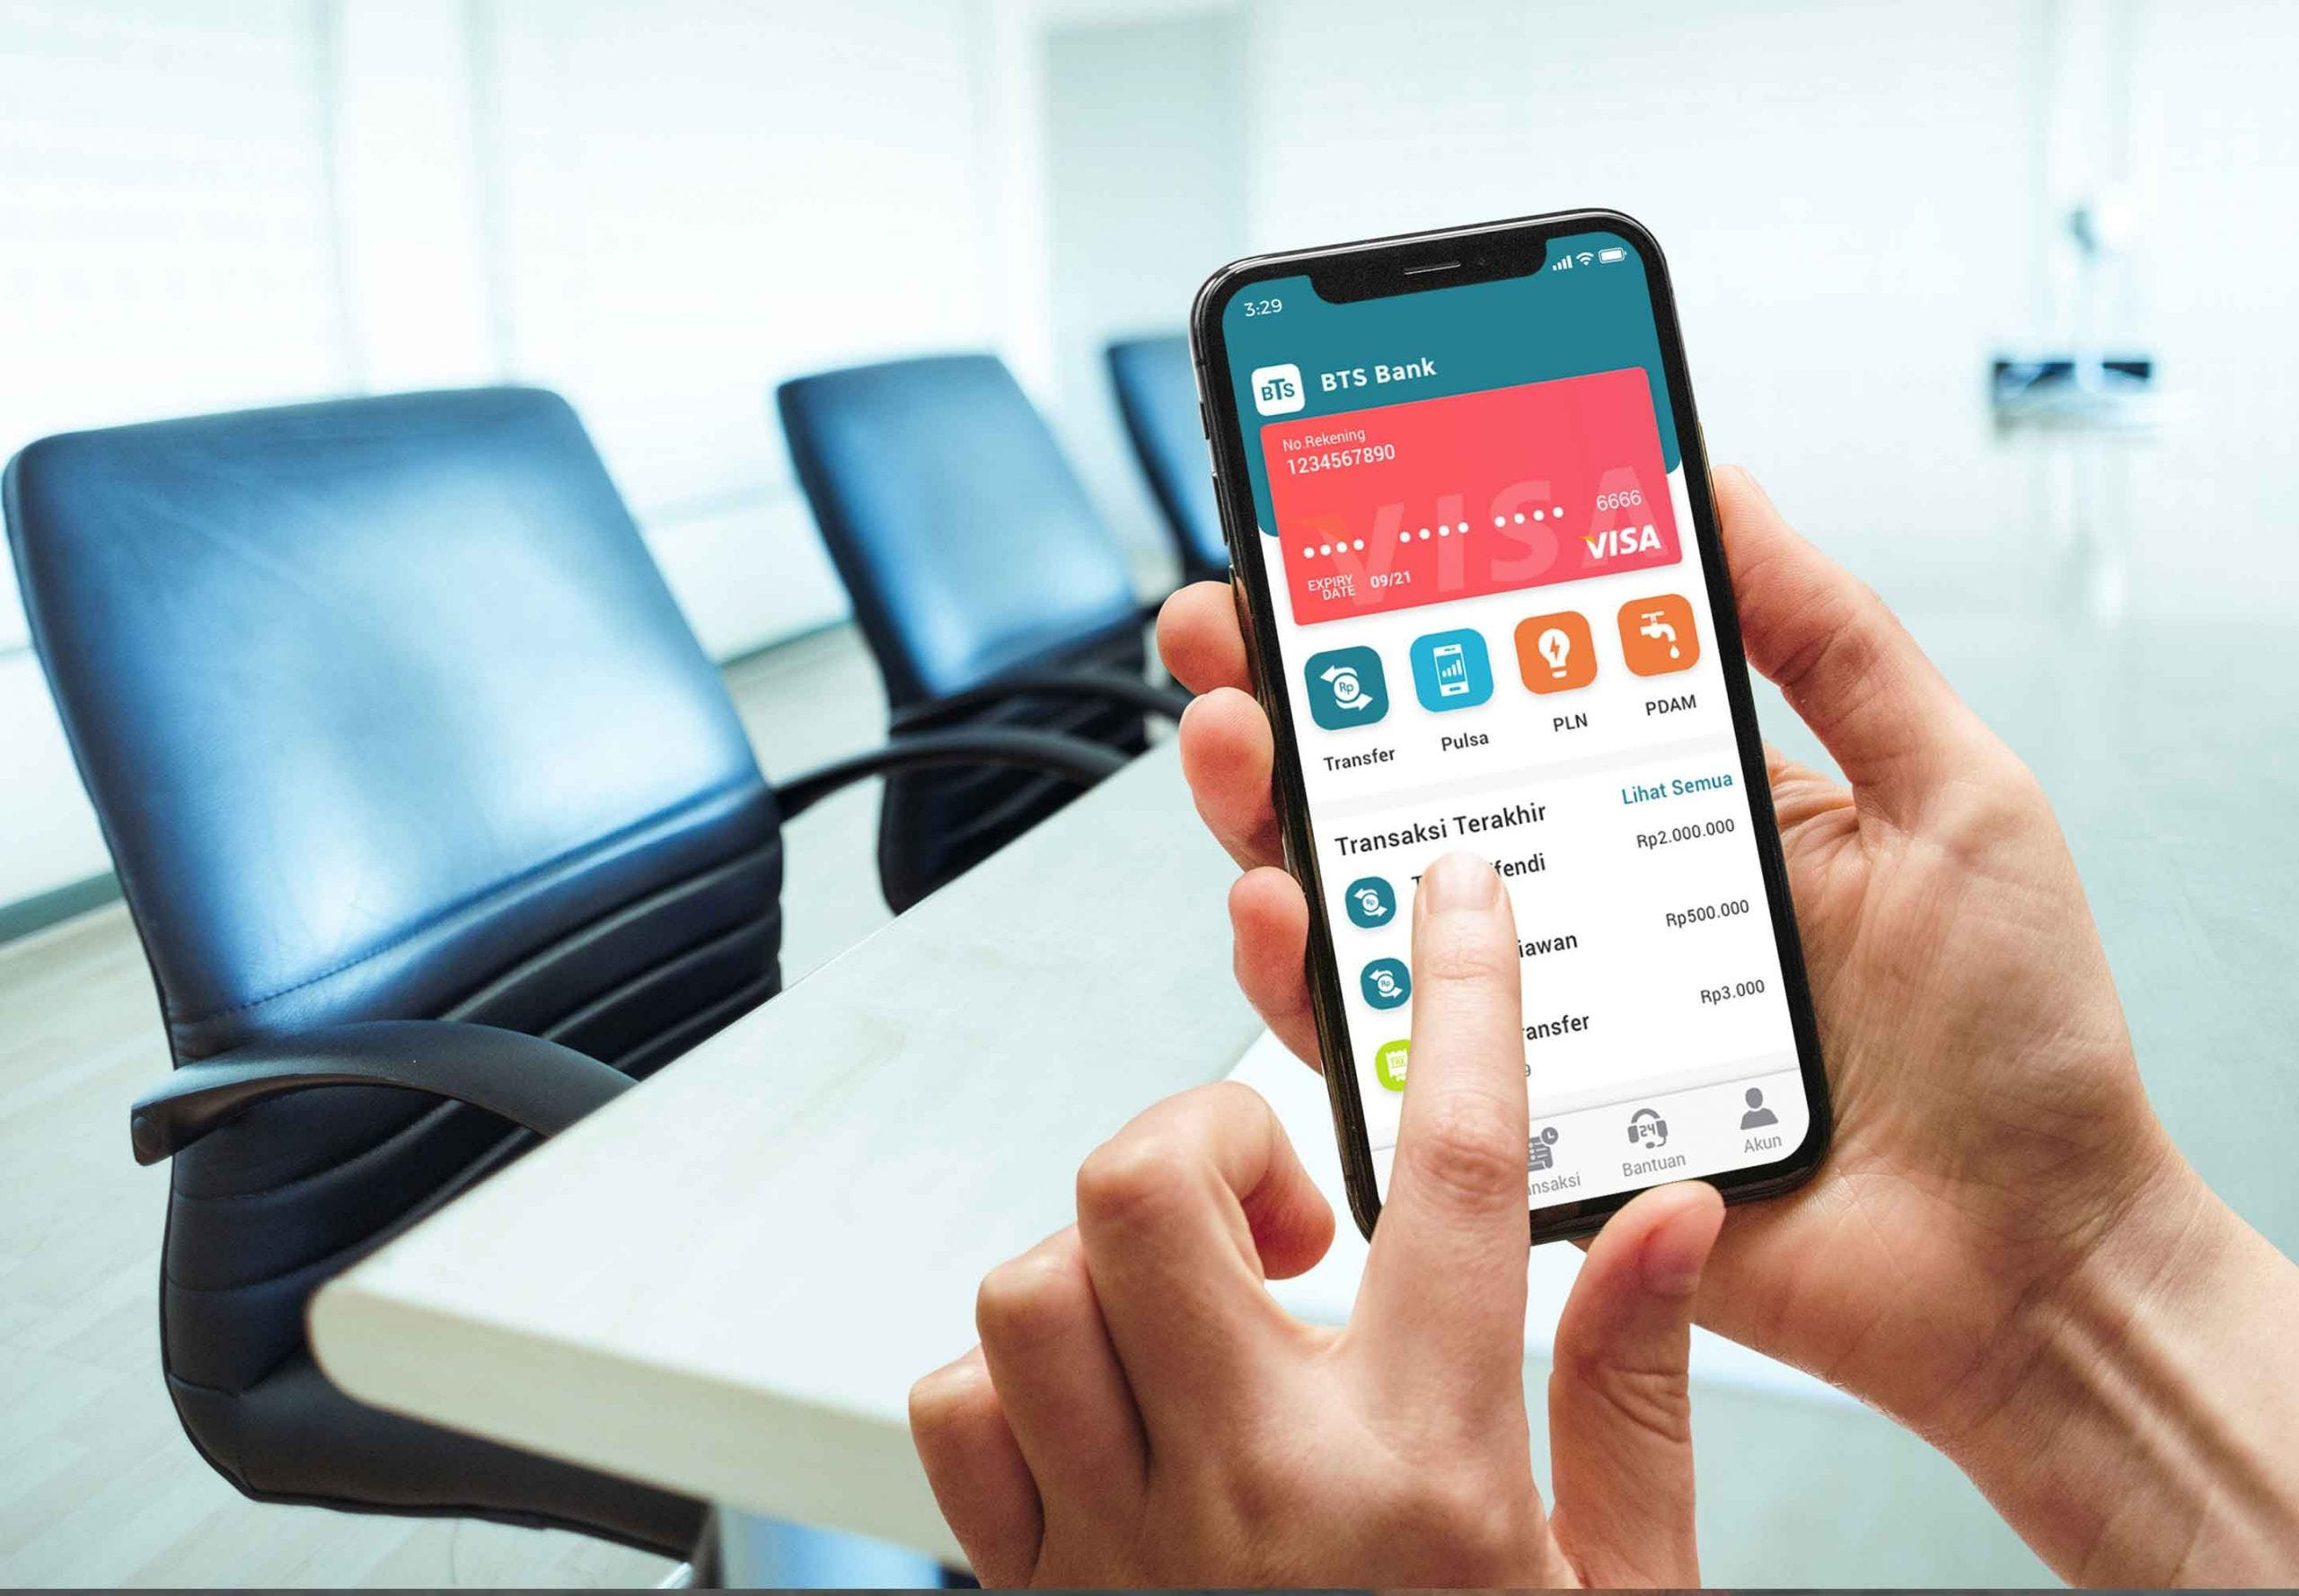
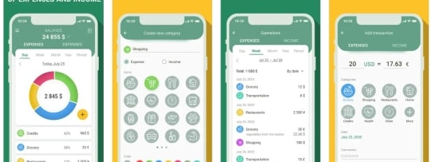
USER SEGMENTS
Target Audience & Use Cases
Serving diverse user segments with tailored experiences
BUSY PROFESSIONALS
SENIOR CITIZENS
YOUNG ADULTS
Professionals
Seniors
Students
Busy individuals needing quick banking access during work hours. They value efficiency and time-saving solutions.
Older adults who prefer simple, conversational interfaces over complex mobile apps and websites.
Young adults managing finances independently for the first time, seeking convenient digital solutions.
Quick Balance Checks
Easy Balance Inquiries
Account Management
Instant account overview during busy schedules
Simple natural language queries
Monitor student account balances
Money Transfers
Banking FAQs
ATM Locator
Seamless fund transfers without visiting branches
Answers about branch hours and policies
Find nearby ATMs on campus
Transaction History
Card Blocking
Loan Information
Track recent spending on-the-go
Immediate assistance for lost cards
Explore student loan options

Slide 21

THE FUTURE IS NOW
Transforming Banking
with AI
BankBot AI demonstrates how AI and NLP can transform traditional banking into a smart, efficient, and user-friendly digital system.
The future of banking is conversational, intelligent, and always accessible.
Intelligent
Secure
24/7 Available
User-Friendly
Thank You
Vallivedu Madhuri Reddy
Questions & Discussion Welcome
BankBot AI Project

